Slide 1
Single Cycle CPU Design
Based on MIPS Instruction Set
By: Shane Davey

Slide 2
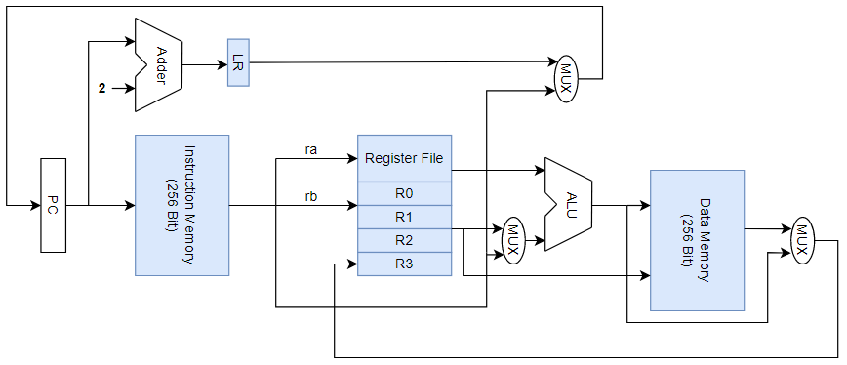
Design Overview

Slide 3
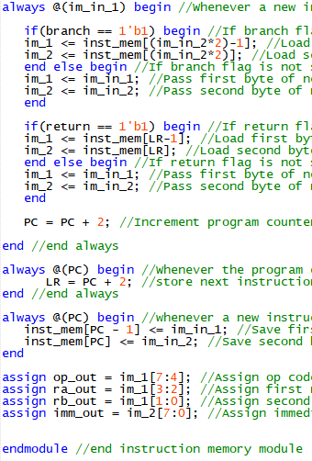
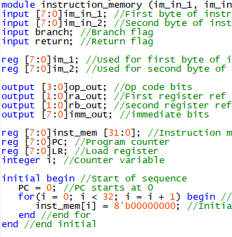
Instruction Memory

Slide 4
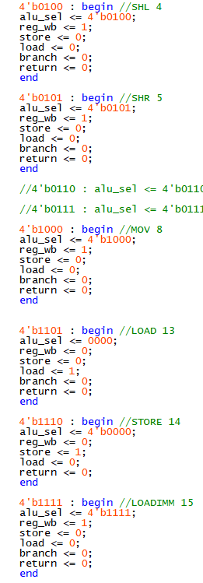
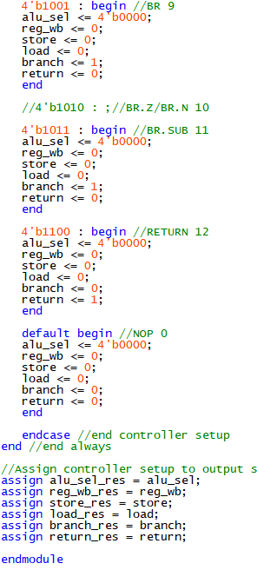
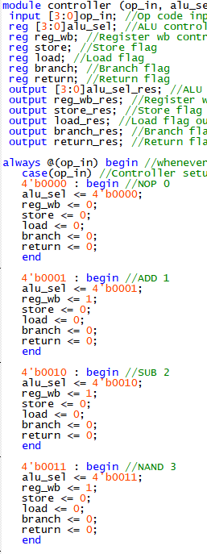
Controller

Slide 5
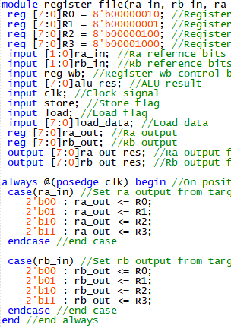
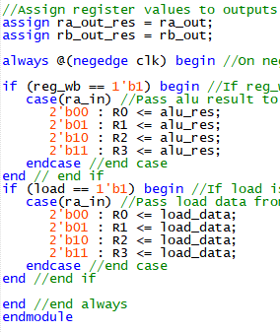
Register File

Slide 6
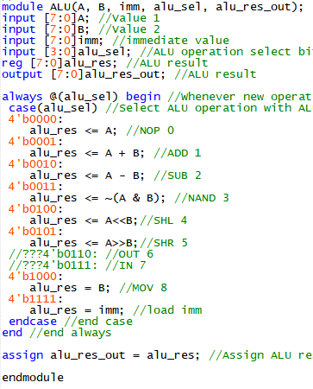
Arithmetic Logic Unit

Slide 7
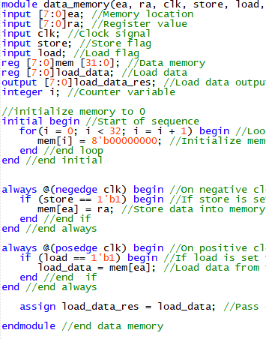
Data Memory

Slide 8
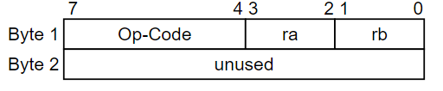
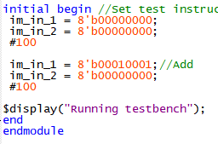


A-Format Instruction
Test Bench
Output
Initial Registers

Slide 9

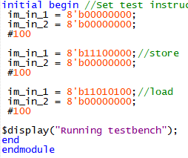

L-Format Instruction
Test Bench
Output
Initial Registers

Slide 10
Future Work
Pseudocode
Full Instructions
Hardware Implementation
Refactoring

